Slide 1



Contrast Data Mining: Methods and Applications
James Bailey, NICTA Victoria Laboratory and The University of Melbourne
Guozhu Dong, Wright State University
Presented at the IEEE International Conference on Data Mining (ICDM), October 28-31 2007
An up to date version of this tutorial is available at http://www.csse.unimelb.edu.au/~jbailey/contrast

Slide 2
Contrast data mining - What is it ?
Contrast - ``To compare or appraise in respect to differences’’ (Merriam Webster Dictionary)
Contrast data mining - The mining of patterns and models contrasting two or more classes/conditions.

Slide 3
Contrast Data Mining - Why ?
``Sometimes it’s good to contrast what you like with something else. It makes you appreciate it even more’’
Darby Conley, Get Fuzzy, 2001

Slide 4
What can be contrasted ?
Objects at different time periods
  ``Compare ICDM papers published in 2006-2007 versus those in 2004-2005’’
Objects for different spatial locations
  ``Find the distinguishing features of location x for human DNA, versus location x for mouse DNA’’
Objects across different classes
  ``Find the differences between people with brown hair, versus those with blonde hair’’

Slide 5
What can be contrasted ? Cont.
Objects within a class
  ``Within the academic profession, there are few people older than 80’’ (rarity)
  ``Within the academic profession, there are no rich people’’ (holes)
  ``Within computer science, most of the papers come from USA or Europe’’ (abundance)
Object positions in a ranking
  ``Find the differences between high and low income earners’’
Combinations of the above

Slide 6
Alternative names for contrast data mining
Contrast={change, difference, discriminator, classification rule, …}
Contrast data mining is related to topics such as:
Change detection, class based association rules, contrast sets, concept drift, difference detection, discriminative patterns, (dis)similarity index, emerging patterns, gradient mining, high confidence patterns, (in)frequent patterns, top k patterns,……

Slide 7
Characteristics of contrast data mining
Applied to multivariate data
Objects may be relational, sequential, graphs, models, classifiers, combinations of these
Users may want either
  To find multiple contrasts (all, or top k)
  A single measure for comparison
    ``The degree of difference between the groups (or models) is 0.7’’

Slide 8
Contrast characteristics Cont.
Representation of contrasts is important. Needs to be
  Interpretable, non redundant, potentially actionable, expressive
  Tractable to compute
Quality of contrasts is also important. Need
  Statistical significance, which can be measured in multiple ways
  Ability to rank contrasts is desirable, especially for classification

Slide 9
How is contrast data mining used ?
Domain understanding
  ``Young children with diabetes have a greater risk of hospital admission, compared to the rest of the population
Used for building classifiers
  Many different techniques - to be covered later
  Also used for weighting and ranking instances
Used in construction of synthetic instances
  Good for rare classes
Used for alerting, notification and monitoring
  ``Tell me when the dissimilarity index falls below 0.3’’

Slide 10
Goals of this tutorial
Provide an overview of contrast data mining
Bring together results from a number of disparate areas.
  Mining for different types of data
    Relational, sequence, graph, models, …
  Classification using discriminating patterns

Slide 11
By the end of this tutorial you will be able to …
Understand some principal techniques for representing contrasts and evaluating their quality
Appreciate some mining techniques for contrast discovery
Understand techniques for using contrasts in classification

Slide 12
Don’t have time to cover ..
String algorithms
Connections to work in inductive logic programming
Tree-based contrasts
Changes in data streams
Frequent pattern algorithms
Connections to granular computing
…

Slide 13
Outline of the tutorial
Basic notions and univariate contrasts
Pattern and rule based contrasts
Contrast pattern based classification
Contrasts for rare class datasets
Data cube contrasts
Sequence based contrasts
Graph based contrasts
Model based contrasts
Common themes + open problems + summary

Slide 14
Basic notions and univariate case
Feature selection and feature significance tests can be thought of as a basic contrast data mining activity.
  ``Tell me the discriminating features’’
    Would like a single quality measure
    Useful for feature ranking
  Emphasis is less on finding the contrast and more on evaluating its power

Slide 15
Sample Feature-Class Dataset
ID | Height (cm) | Class
9004 | 150 | Happy ☺
1005 | 200 | Sad ☹
9006 | 137 | Happy ☺
4327 | 120 | Happy ☺
3325 | …… | …..

Slide 16
Discriminative power
Can assess discriminative power of Height feature by
  Information measures (signal to noise, information gain ratio, …)
  Statistical tests (t-test, Kolmogorov-Smirnov, Chi squared, Wilcoxon rank sum, …). Assessing whether
    The mean of each class is the same
    The samples for each class come from the same distribution
    How well a dataset fits a hypothesis
No single test is best in all situations !

Slide 17
Example Discriminative Power Test - Wilcoxon Rank Sum
Suppose n₁ happy, and n₂ sad instances
Sort the instances according to height value:
h₁ <= h₂ <= h₃ <= … h_{n1+n2}
Assign a rank to each instance, indicating how many instances in the other class are less. For x in class A
For each class
  Compute the Ranksum=Sum(ranks of all its instances)
  Null Hypothesis: The instances are from the same distribution
  Consult statistical significance table to determine whether value of Ranksum is significant
Rank(x)=|{y: class(y)<>A and height(y)<height(x)}|

Slide 18
Rank Sum Calculation Example
ID | Height(cm) | Class | Rank
324 | 220 | Happy ☺ | 3
481 | 210 | Sad ☹ | 2
660 | 190 | Sad ☹ | 2
321 | 177 | Happy ☺ | 1
415 | 150 | Sad ☹ | 1
816 | 120 | Happy ☺ | 0
Happy: RankSum=3+1+0=4 Sad:RankSum=2+2+1=5

Slide 19
Wilcoxon Rank Sum TestCont.
Non parametric (no normal distribution assumption)
Requires an ordering on the attribute values
Scaled value of Ranksum is equivalent to area under ROC curve for using the selected feature as a classifier
100%
True Positive Rate
Ranksum
(n₁*n₂)
0%
0%
False Positive Rate
100%

Slide 20
Discriminating with attribute values
Can alternatively focus on significance of attribute values, with either
1) Frequency/infrequency (high/low counts)
  Frequent in one class and infrequent in the other.
    There are 50 happy people of height 200cm and only 2 sad people of height 200cm
2) Ratio (high ratio of support)
  Appears X times more in one class than the other
    There are 25 times more happy people of height 200cm than sad people of height 200cm

Slide 21
Attribute/Feature Conversion
Possible to form a new binary feature based on attribute value and then apply feature significance tests
  Blur distinction between attribute and attribute value
150cm | 200cm | … | Class
Yes | No | … | Happy ☺
No | Yes | … | Sad ☹

Slide 22
Discriminating Attribute Values in a Data Stream
Detecting changes in attribute values is an important focus in data streams
  Often focus on univariate contrasts for efficiency reasons
  Finding when change occurs (non stationary stream).
  Finding the magnitude of the change. E.g. How big is the distance between two samples of the stream ?
  Useful for signaling necessity for model update or an impending fault or critical event

Slide 23
Odds ratio and Risk ratio
Can be used for comparing or measuring effect size
Useful for binary data
Well known in clinical contexts
Can also be used for quality evaluation of multivariate contrasts (will see later)
A simple example given next

Slide 24
Odds and risk ratio Cont.
ID | Gender (feature) | Exposed (event)
1 | Male | Yes
2 | Female | No
3 | Male | No
4 | … | …

Slide 25
Odds Ratio Example
Suppose we have 100 men and 100 women, and 70 men and 10 women have been exposed
  Odds of exposure(male)=0.7/0.3=2.33
  Odds of exposure(female)=0.1/0.9=0.11
  Odds ratio=2.33/.11=21.2
Males have 21.2 times the odds of exposure than females
Indicates exposure is much more likely for males than for females

Slide 26
Relative Risk Example
Suppose we have 100 men and 100 women, and 70 men and 10 women have been exposed
  Relative risk of exposure (male)=70/100=0.7
  Relative risk of exposure(female)=10/100=0.1
  The relative risk=0.7/0.1=7
Men 7 times more likely to be exposed than women

Slide 27
Pattern/Rule Based Contrasts
Overview of ``relational’’ contrast pattern mining
Emerging patterns and mining
  Jumping emerging patterns
  Computational complexity
  Border differential algorithm
    Gene club + border differential
    Incremental mining
  Tree based algorithm
  Projection based algorithm
  ZBDD based algorithm
Bioinformatic application: cancer study on microarray gene expression data

Slide 28
Overview
Class based association rules (Cai et al 90, Liu et al 98, ...)
Version spaces (Mitchell 77)
Emerging patterns (Dong+Li 99) – many algorithms (later)
Contrast set mining (Bay+Pazzani 99, Webb et al 03)
Odds ratio rules & delta discriminative EP (Li et al 05, Li et al 07)
MDL based contrast (Siebes, KDD07)
Using statistical measures to evaluate group differences (Hilderman+Peckman 05, Webb 07)
Spatial contrast patterns (Arunasalam et al 05)
…… see references

Slide 29
Classification/Association Rules
Classification rules -- special association rules
(with just one item – class -- on RHS):
  X → C (s,c)
    X is a pattern,
    C is a class,
    s is support,
    c is confidence

Slide 30
Version Space (Mitchell)
-
gen, short
true
+
spec, long
Version space: the set of all patterns consistent with given (D+,D-) – patterns separating D+, D-.
  The space is delimited by a specific & a general boundary.
  Useful for searching the true hypothesis, which lies somewhere b/w the two boundaries.
  Adding +ve examples to D+ makes the specific boundary more general; adding -ve examples to D- makes the general boundary more specific.
Common pattern/hypothesis language operators: conjunction, disjunction
Patterns/hypotheses are crisp; need to be generalized to deal with percentages; hard to deal with noise in data

Slide 31
STUCCO, MAGNUM OPUS for contrast pattern mining
STUCCO (Bay+Pazzani 99)
  Mining contrast patterns X (called contrast sets) between
  k>=2 groups: |supp_{i}(X) – supp_{j}(X)| >= minDiff
  Use Chi2 to measure statistical significance of contrast patterns
    significance cut-off thresholds change, based on the level of the node and the local number of contrast patterns
  Max-Miner like search strategy, plus some pruning techniques
MAGNUM OPUS (Webb 01)
  An association rule mining method, using Max-Miner like approach (proposed before, and independently of, Max-Miner)
  Can mine contrast patterns (by limiting RHS to a class)

Slide 32
Contrast patterns vs decision tree based rules
It has been recognized by several authors (e.g. Bay+Pazzani 99) that
  rules generation from decision trees can be good contrast patterns,
  but may miss many good contrast patterns.
Different contrast set mining algorithms have different thresholds
  Some have min support threshold
  Some have no min support threshold; low support patterns may be useful for classification etc

Slide 33
Emerging Patterns
Emerging Patterns (EPs) are contrast patterns between two classes of data whose support changes significantly between the two classes. Change significance can be defined by:
If supp2(X)/supp1(X) = infinity, then X is a jumping EP.
  jumping EP occurs in some members of one class but never occurs in the other class.
Conjunctive language; extension to disjunctive EP later
big support ratio:
supp2(X)/supp1(X) >= minRatio
similar to RiskRatio; +: allowing patterns with small overall support
big support difference:
|supp2(X) – supp1(X)| >= minDiff
(as defined by Bay+Pazzani 99)
0.7-0.6 = 0.105-0.005
Notes:
Bay 99 proposed a STUCCO algorithm, which uses chi2 to measure statistical significance of contrast sets.
Webb uses Magnum Opus to mine contrast sets.

Slide 34
A typical EP in the Mushroom dataset
The Mushroom dataset contains two classes: edible and poisonous.
Each data tuple has several features such as: odor, ring-number, stalk-surface-bellow-ring, etc.
Consider the pattern
{odor = none,
stalk-surface-below-ring = smooth,
ring-number = one}
Its support increases from 0.2% in the poisonous class to 57.6% in the edible class (a growth rate of 288).

Slide 35
Example EP in microarray data for cancer
Normal Tissues Cancer Tissues
Jumping EP: Patterns w/ high support ratio b/w data classes
E.G. {g1=L,g2=H,g3=L}; suppN=50%, suppC=0
each subset occurs in both class
binned data
g1 | g2 | g3 | g4
L | H | L | H
L | H | L | L
H | L | L | H
L | H | H | L
g1 | g2 | g3 | g4
H | H | L | H
L | H | H | H
L | L | L | H
H | H | H | L

Slide 36
Top support minimal jumping EPs for colon cancer
These EPs have 95%--100% support in one class but 0% support in the other class.
Minimal: Each proper subset occurs in both classes.
Colon Cancer EPs
{1+ 4- 112+ 113+} 100%
{1+ 4- 113+ 116+} 100%
{1+ 4- 113+ 221+} 100%
{1+ 4- 113+ 696+} 100%
{1+ 108- 112+ 113+} 100%
{1+ 108- 113+ 116+} 100%
{4- 108- 112+ 113+} 100%
{4- 109+ 113+ 700+} 100%
{4- 110+ 112+ 113+} 100%
{4- 112+ 113+ 700+} 100%
{4- 113+ 117+ 700+} 100%
{1+ 6+ 8- 700+} 97.5%
Colon Normal EPs
{12- 21- 35+ 40+ 137+ 254+} 100%
{12- 35+ 40+ 71- 137+ 254+} 100%
{20- 21- 35+ 137+ 254+} 100%
{20- 35+ 71- 137+ 254+} 100%
{5- 35+ 137+ 177+} 95.5%
{5- 35+ 137+ 254+} 95.5%
{5- 35+ 137+ 419-} 95.5%
{5- 137+ 177+ 309+} 95.5%
{5- 137+ 254+ 309+} 95.5%
{7- 21- 33+ 35+ 69+} 95.5%
{7- 21- 33+ 69+ 309+} 95.5%
{7- 21- 33+ 69+ 1261+} 95.5%
EPs from Mao+Dong 05 (gene club + border-diff).
There are ~1000 items with supp >= 80%.
Very few 100% support EPs.
Colon cancer dataset (Alon et al, 1999 (PNAS)): 40 cancer tissues, 22 normal tissues. 2000 genes

Slide 37
A potential use of minimal jumping EPs
Minimal jumping EPs for normal tissues
➔ Properly expressed gene groups important for normal cell functioning, but destroyed in all colon cancer tissues
➔ Restore these ➔ ?cure colon cancer?
Minimal jumping EPs for cancer tissues
➔ Bad gene groups that occur in some cancer tissues but never occur in normal tissues
➔ Disrupt these ➔ ?cure colon cancer?
? Possible targets for drug design ?
Li+Wong 2002 proposed “gene therapy using EP” idea: therapy aims to destroy bad JEP & restore good JEP
Notes:
Jinyan Li, Limsoon Wong. Identifying good diagnostic genes or genes groups
from gene expression data by using the concept of emerging patterns.
Bioinformatics. 18:725--734, 2002. Corrigendum. Bioinformatics,
18:1407--1408, 2002.
This paper (and its corrigendum) was
written prior to development of PCL.

Slide 38
Usefulness of Emerging Patterns
EPs are useful
  for building highly accurate and robust classifiers, and for improving other types of classifiers
  for discovering powerful distinguishing features between datasets.
Like other patterns composed of conjunctive combination of elements, EPs are easy for people to understand and use directly.
EPs can also capture patterns about change over time.
Papers using EP techniques in Cancer Cell (cover, 3/02).
Emerging Patterns have been applied in medical applications for diagnosing acute Lymphoblastic Leukemia.

Slide 39
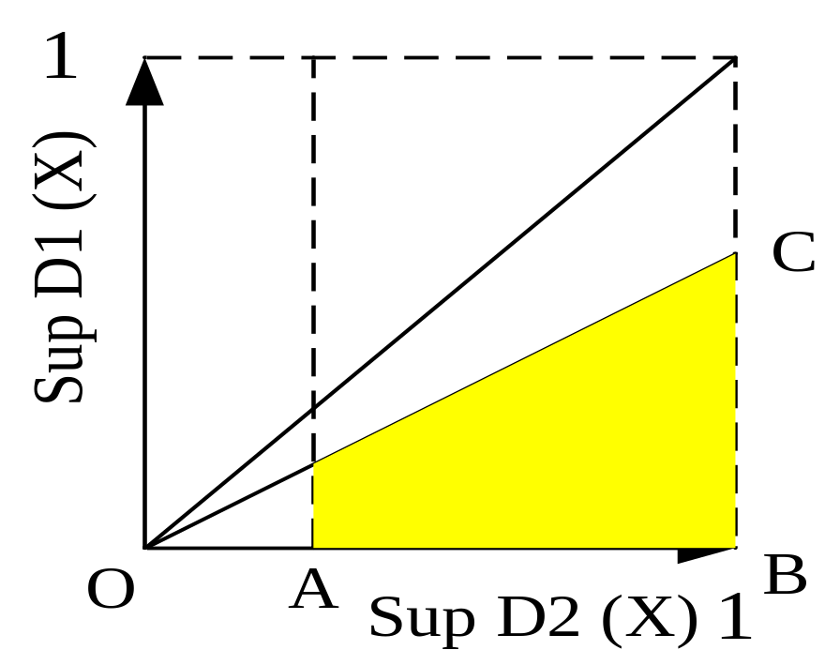
The landscape of EPs on the support plane, and challenges for mining
Landscape of EPs
rectangle: s2 >=beta, s1 <=alpha
Challenges for EP mining
EP minRatio constraint is neither monotonic nor anti-monotonic (but exceptions exist for special cases)
Requires smaller support thresholds than those used for frequent pattern mining
Notes:
The mining algs, such as those for jumping eps
are exploiting (anti) monotonic properties, for either the
positive or the negative separately. There will also be a later mention
that the ratio constraint can become (anti)monotonic when stratified into
support levels.

Slide 40
Odds Ratio and Relative Risk Patterns [Li and Wong PODS06]
May use odds ratio/relative risk to evaluate compound factors as well
  Maybe no single factor has high relative risk or odds ratio, but a combination of factors does
    Relative risk patterns - Similar to emerging patterns
    Risk difference patterns - Similar to contrast sets
    Odds ratio patterns

Slide 41
Mining Patterns with High Odds Ratio or Relative Risk
Space of odds ratio patterns and relative risk patterns are not convex in general
Can become convex, if stratified into plateaus, based on support levels

Slide 42
EP Mining Algorithms
Complexity result (Wang et al 05)
Border-differential algorithm (Dong+Li 99)
Gene club + border differential (Mao+Dong 05)
Constraint-based approach (Zhang et al 00)
Tree-based approach (Bailey et al 02, Fan+Kotagiri 02)
Projection based algorithm (Bailey el al 03)
ZBDD based method (Loekito+Bailey 06).

Slide 43
Complexity result
The complexity of finding emerging patterns (even those with the highest frequency) is MAX SNP-hard.
  This implies that polynomial time approximation schemes do not exist for the problem unless P=NP.

Slide 44
Borders are concise representations of convex collections of itemsets
< minB={12,13}, maxB={12345,12456}>
  123, 1234
  12 124, 1235 12345
  125, 1245 12456
  126, 1246
  13 134, 1256
  135, 1345
A collection S is convex: If for all X,Y,Z (X in S, Y in S, X subset Z subset Y) ➔ Z in S.

Slide 45
Border-Differential Algorithm
<{{}},{1234}> - <{{}},{2356,2457,3468}>
= <{1,234},{1234}>
{}
  1, 2, 3, 4
  12, 13, 14, 23, 24, 34
  123, 124, 134, 234
  1234
Good for: Jumping EPs; EPs in “rectangle regions,” …
Algorithm:
Use iterations of expansion & minimization of “products” of differences
Use tree to speed up minimization
Find minimal subsets of 1234 that are not subsets of 2356, 2457, 3468.
{1,234} = min ({1,4} X {1,3} X {1,2})
Iterative expansion & minimization can be viewed as optimized Berge hypergraph transversal algorithm

Slide 46
Gene club + Border Differential
Border-differential can handle up to 75 attributes (using 2003 PC)
For microarray gene expression data, there are thousands of genes.
(Mao+Dong 05) used border-differential after finding many gene clubs -- one gene club per gene.
A gene club is a set of k genes strongly correlated with a given gene and the classes.
Some EPs discovered using this method were shown earlier. Discovered more EPs with near 100% support in cancer or normal, involving many different genes. Much better than earlier results.
EPs: gene interactions of potential importance for the disease

Slide 47
Tree-based algorithm for JEP mining
Use tree to compress data and patterns.
Tree is similar to FP tree, but it stores two counts per node (one per class) and uses different item ordering
Nodes with non-zero support for positive class and zero support for negative class are called base nodes.
For every base node, the path’s itemset contains potential JEPs. Gather negative data containing root item and items for based nodes on the path. Call border differential.
Item ordering is important. Hybrid (support ratio ordering first for a percentage of items, frequency ordering for other items) is best.

Slide 48
Projection based algorithm
Let H be:
a b c d (edge 1)
b d e (edge 2)
b c e (edge 3)
c d e (edge 4)
Item ordering:
a < b < c < d < e
Ha is H with all items > a (red items) projected out and also edge with a removed, so Ha={}.
Hd = {bc}
Form dataset H containing the differences
{p-ni | i=1…k}.
  p is a positive transaction, n1, …, nk are negative transactions.
Find minimal transverals of hypergraph H. i.e. The smallest sets intersecting every edge (equivalent to the smallest subsets of p not contained in any ni).
Let x1<…<xm be increasing item frequency (in H) ordering.
For i=1 to m
  let Hxi be H with all items y > xi projected out & all transactions containing xi removed (data projection).
  remove non minimal transactions in Hxi.
  if Hxi is small, apply border differential
  Otherwise, apply the algorithm on Hxi.

Slide 49
ZBDD based algorithm to mine disjunctive emerging patterns
Disjunctive Emerging Patterns: allowing disjunction as well as conjunction of simple attribute conditions.
  e.g. Precipitation = ( gt-norm OR lt-norm ) AND Internal discoloration = ( brown OR black )
  Generalization of EPs
  Some datasets do not contain high support EPs but contain high support disjunctive EPs
ZBDD based algorithm uses Zero Suppressed Binary Decision Diagram for efficiently mining disjunctive EPs.

Slide 50
Binary Decision Diagrams (BDDs)
Popular in boolean SAT solvers and reliability eng.
Canonical DAG representations of boolean formulae
Node sharing: identical nodes are shared
Caching principle: past computation results are automatically stored and can be retrieved
Efficient BDD implementations available, e.g. CUDD (U of Colorado)
c
root
f = (c Λ a) v (d Λ a)
0
1
d
c
a
d
dotted (or 0) edge: don’t link the nodes (in formulae)
0
a
0
1
a
0
1
0
1
Notes:
Binary Decision Diagrams, or BDDs, are popular in boolean SAT solvers and in the field of reliability engineering.
They are canonical directed acyclic graph. They are canonical because identical nodes are shared, so each node may have multiple incoming links.
An advanced utility of BDDs is they employ caching principle which stores the result from past computations, and they can be reused when they are needed.
This principle is most effective if there is much node sharing inside the structure.
Also, there exist a number of efficient BDD implementations that are publically available. We use the one developed by the univ of colorado called CUDD.

Slide 51
ZBDD Representation of Itemsets
Zero-suppressed BDD, ZBDD : A BDD variant for manipulation of item combinations
E.g. Building a ZBDD for {{a,b,c,e},{a,b,d,e},{b,c,d}}
  Ordering : c < d < a < e < b
{{a,b,c,e}}
{{a,b,d,e}}
{{a,b,c,e},{a,b,d,e},
{b,c,d}}
U_{z}
=
{{a,b,c,e},{a,b,d,e}}
U_{z}
{{b,c,d}}
=
c
d
c
c
c
d
d
a
a
a
d
d
U_{z}
=
U_{z}
=
a
e
e
e
e
b
b
b
b
b
0
1
0
1
0
1
0
1
0
1
U_{z} = ZBDD set-union
Notes:
To construct a ZBDD for a given set of itemsets, we add them to the ZBDD one at a time.
Supposing we are given this set of itemsets, and the ZBDD follows this item ordering : c,d,a,e,b
Firstly it constructs a ZBDD for the first itemset: abce.
We interpret this structure as follows. The structure has one root node and two sink nodes: 0 and 1 (shown in squares at the bottom).
Each node represents an item, and outgoing edges shown by solid lines mean the item occurs in the itemset, the dotted lines mean the item does not occur in the itemset.
So, each path from the root to sink-1 corresponds to an itemset occuring in the set, and all other paths correspond to itemsets not occuring in the set.
After processing the first itemset, it reads the second itemset: a,b,d,e, build a new ZBDD for it,
and then compute the union with the previous ZBDD.
What is nice about using BDD is that its caching principle allows set-operations (union, intersection, etc) can be done in polynomial time wrt. the number of nodes.

Slide 52
ZBDD based mining example
Use solid paths in ZBDD(D_{n}) to generate candidates, and use Bitmap of D_{p} to check frequency support in D_{p}.
ZBDD(D_{n})
Bitmap
a b c d e f g h i
P1: 1 0 0 0 1 0 1 0 0
P2: 1 0 0 1 0 0 0 0 1
P3: 0 1 0 0 0 1 0 1 0
P4: 0 0 1 0 1 0 0 1 0
N1: 1 0 0 0 0 1 1 0 0
N2: 0 1 0 1 0 0 0 1 0
N3: 0 1 0 0 0 1 0 1 0
N4: 0 0 1 0 1 0 1 0 0
D_{p}
D_{n}
a
D_{p}=
A1
A2
A3
A1
A2
A3
c
c
a
e
g
a
f
g
d
d
d
a
d
i
b
d
h
e
D_{n}=
e
b
b
f
h
b
f
h
e
c
e
h
c
e
g
b
f
f
h
g
1
Ordering: a<c<d<e<b<f<g<h
Notes:
How does the algorithm work?
Let us consider the previous synthetic data example.
We firstly construct a ZBDD containing the complement of the negative dataset. If a pattern is contained by a particular transcation, it intersects with the transaction’s complement.
The candidate patterns are grown using the first item which occurs at the top node in the ZBDD. In this case, it is the item a.
Incrementally growing a pattern candidate means growing a path in the output ZBDD.
However, before this pattern is grown further, we need to calculate its support using the bitmap. So we are now looking at the column in the bitmap for the positive, which corresponds to the occurrences of ‘a’.
If the new candidate is frequent enoug in the positive class, then it may be grown recursively using P0, the partition of the input ZBDD which do not contain ‘a’.
In this framework, this lattice shows the candidates which are being generated. Starts wiith the empty itemset, itemset {a}, and then growing it by one item at a time, generating {a,c}, {ad}, and so on.
Once all the extensions for the item ‘a’ have all been mined, then we need to mine the patterns which don’t contain ‘a’, and how do we do that?
It requires 2 steps: first is to compute a db projection by merging the remaining database. This is given by the set-union between the two partitions of the input ZBDD: the partition that contains ‘a’ and the partition that does not contain ‘a’.
Then, the remaining candidate pattersn are generated using the merged DB.

Slide 53
Contrast pattern based classification
-- history
Contrast pattern based classification: Methods to build or improve classifiers, using contrast patterns
  CBA (Liu et al 98)
  CAEP (Dong et al 99)
  Instance based method: DeEPs (Li et al 00, 04)
  Jumping EP based (Li et al 00), Information based (Zhang et al 00), Bayesian based (Fan+Kotagiri 03), improving scoring for >=3 classes (Bailey et al 03)
  CMAR (Li et al 01)
  Top-ranked EP based PCL (Li+Wong 02)
  CPAR (Yin+Han 03)
  Weighted decision tree (Alhammady+Kotagiri 06)
  Rare class classification (Alhammady+Kotagiri 04)
  Constructing supplementary training instances (Alhammady+Kotagiri 05)
  Noise tolerant classification (Fan+Kotagiri 04)
  EP length based 1-class classification of rare cases (Chen+Dong 06)
  …
Most follow the aggregating approach of CAEP.

Slide 54
EP-based classifiers: rationale
Consider a typical EP in the Mushroom dataset, {odor = none, stalk-surface-below-ring = smooth, ring-number = one}; its support increases from 0.2% from “poisonous” to 57.6% in “edible” (growth rate = 288).
Strong differentiating power: if a test T contains this EP, we can predict T as edible with high confidence 99.6% = 57.6/(57.6+0.2)
A single EP is usually sharp in telling the class of a small fraction (e.g. 3%) of all instances. Need to aggregate the power of many EPs to make the classification.
EP based classification methods often out perform state of the art classifiers, including C4.5 and SVM. They are also noise tolerant.
growthRate: supRatio

Slide 55
CAEP (Classification by Aggregating Emerging Patterns)
Given a test case T, obtain T’s scores for each class, by aggregating the discriminating power of EPs contained in T; assign the class with the maximal score as T’s class.
The discriminating power of EPs are expressed in terms of supports and growth rates. Prefer large supRatio, large support
The contribution of one EP X (support weighted confidence):
strength(X) = sup(X) * supRatio(X) / (supRatio(X)+1)
Compare CMAR: Chi2 weighted Chi2
Given a test T and a set E(Ci) of EPs for class Ci, the aggregate score of T for Ci is
score(T, Ci) = Σ strength(X) (over X of Ci matching T)
For each class, may use median (or 85%) aggregated value to normalize to avoid bias towards class with more EPs

Slide 56
How CAEP works? An example
Class 1 (D1)
Given a test T={a,d,e}, how to classify T?
a | c | d | e
a | e
b | c | d | e
b
T contains EPs of class 1 : {a,e} (50%:25%) and {d,e} (50%:25%), so Score(T, class1) =
0.5*[2/(2+1)] + 0.5*[2/(2+1)] = 0.67
Class 2 (D2)
T contains EPs of class 2: {a,d} (25%:50%), so Score(T, class 2) = 0.33;
T will be classified as class 1 since Score1>Score2
a | b
a | b | c | d
c | e
a | b | d | e

Slide 57
DeEPs (Decision-making by Emerging Patterns)
An instance based (lazy) learning method, like k-NN; but does not use normal distance measure.
For a test instance T, DeEPs
  First project each training instance to contain only items in T
  Discover EPs from the projected data
  Then use these EPs to get the training data that match some discovered EPs
  Finally, use the proportional size of matching data in a class C as T’s score for C
Advantage: disallow similar EPs to give duplicate votes!

Slide 58
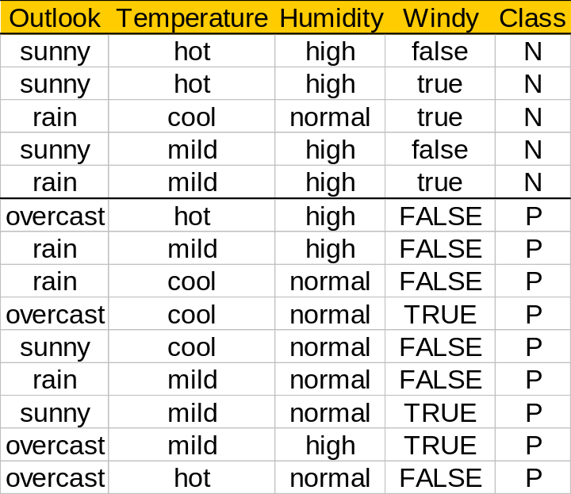
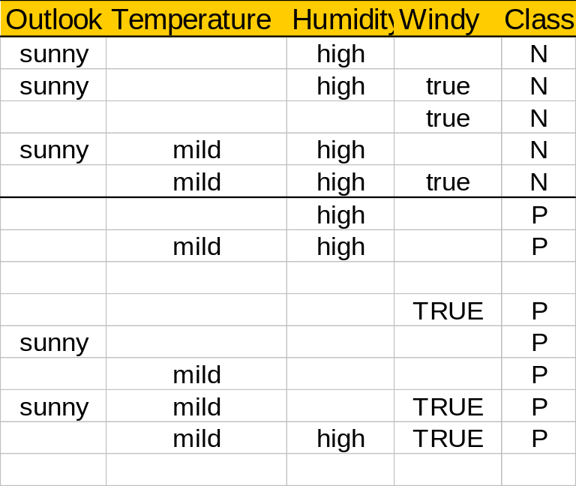
DeEPs : Play-Golf example
Test = {sunny, mild, high, true}
Original data
Projected data
Discover EPs from the projected data
Use discovered EPs to match training data: use matched data’s size to derive score

Slide 59
PCL (Prediction by Collective Likelihood)
Let X1,…,Xm be the m (e.g. 1000) most general EPs in descending support order.
Given a test case T, consider the list of all EPs that match T. Divide this list by EP’s class, and list them in descending support order:
  P class: Xi1, …, Xip
  N class: Xj1, …, Xjn
Use k (e.g. 15) top ranked matching EPs to get score for T for the P class (similarly for N):
Score(T,P) = Σ_{t=1}^{k} suppP(Xit) / supp(Xt)
normalizing factor

Slide 60
Emerging pattern selection factors
There are many EPs, can’t use them all. Should select and use a good subset.
EP selection considerations include
  Use minimal (shortest, most general) ones
  Remove syntactically similar ones
  Use support/growth rate improvement (between superset/subset pairs) to prune
  Use instance coverage/overlap to prune
  Using only infinite growth rate ones (JEPs)
  ……

Slide 61
Why EP-based classifiers are good
Use the discriminating power of low support EPs (with high supRatio), together with high support ones
Use multi-feature conditions, not just single-feature conditions
Select from larger pools of discriminative conditions
  Compare: Search space of patterns for decision trees is limited by early greedy choices.
Aggregate/combine discriminating power of a diversified committee of “experts” (EPs)
Decision is highly explainable

Slide 62
Some other works
CBA (Liu et al 98) uses one rule to make a classification prediction for a test
CMAR (Li et al 01) uses aggregated (Ch2 weighted) Chi2 of matching rules
CPAR (Yin+Han 03) uses aggregation by averaging: it uses the average accuracy of top k rules for each class matching a test case
…

Slide 63
Aggregating EPs/rules vs bagging (classifier ensembles)
Bagging/ensembles: a committee of classifiers vote
  Each classifier is fairly accurate for a large population (e.g. >51% accurate for 2 classes)
Aggregating EPs/rules: matching patterns/rules vote
  Each pattern/rule is accurate on a very small population, but inaccurate if used as a classifier on all data; e.g. 99% accurate on 2% of data, but <2% accurate on all data

Slide 64
Using contrasts for rare class data [Al Hammady and Ramamohanarao 04,05,06]
Rare class data is important in many applications
  Intrusion detection (1% of samples are attacks)
  Fraud detection (1% of samples are fraud)
  Customer click thrus (1% of customers make a purchase)
  …..

Slide 65
Rare Class Datasets
Due to the class imbalance, can encounter some problems
  Few instances in the rare class, difficult to train a classifier
  Few contrasts for the rare class
  Poor quality contrasts for the majority class
Need to either increase the instances in the rare class or generate extra contrasts for it

Slide 66
Synthesising new contrasts
(new emerging patterns)
Synthesising new emerging patterns by superposition of high growth rate items
  Suppose that attribute A2=`a’ has high growth rate and that {A1=`x’, A2=`y’} is an emerging pattern. Then create a new emerging pattern {A1=‘x’, A2=‘a’} and test its quality.
A simple heuristic, but can give surprisingly good classification performance
growth rate: supRatio

Slide 67
Synthesising new data instances
Can also use previously found contrasts as the basis for constructing new rare class instances
  Combine overlapping contrasts and high growth rate items
Main idea - intersect & `cross product’ the emerging patterns & high growth rate (support ratio) items
  Find emerging patterns
  Cluster emerging patterns into groups that cover all the attributes
  Combine patterns within each group to form instances

Slide 68
Synthesising new instances
E1{A1=1, A2=X1}, E2{A5=Y1,A6=2,A7=3}, E3{A2=X2,A3=4,A5=Y2} - this is a group
  V4 is a high growth item for A4
  Combine E1+E2+E3+{A4=V4} to get four synthetic instances.
A1 | A2 | A3 | A4 | A5 | A6 | A7
1 | X1 | 4 | V4 | Y1 | 2 | 3
1 | X1 | 4 | V4 | Y2 | 2 | 3
1 | X2 | 4 | V4 | Y1 | 2 | 3
1 | X2 | 4 | V4 | Y2 | 2 | 3

Slide 69
Measuring instance quality using emerging patterns
[Al Hammady and Ramamohanarao 07]
Classifiers usually assume that data instances are related to only a single class (crisp assignments).
However, real life datasets suffer from noise.
Also, when experts assign an instance to a class, they first assign scores to each class and then assign the class with the highest score.
Thus, an instance may in fact be related to several classes

Slide 70
Measuring instance quality Cont.
For each instance i, assign a weight for its strength of membership in each class.
Can use emerging patterns to determine appropriate weights for instances
Use these weights in a modified version of classifier, e.g. a decision tree
  Modify information gain calculation to take weights into account
Weight(i) = aggregation of EPs divided by
mean value for instances in that class

Slide 71
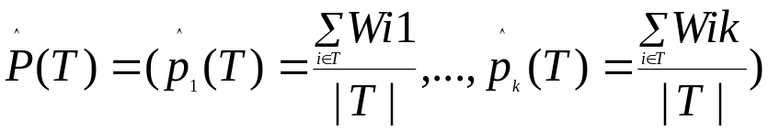
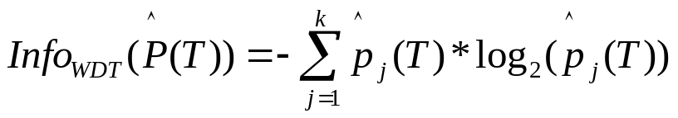
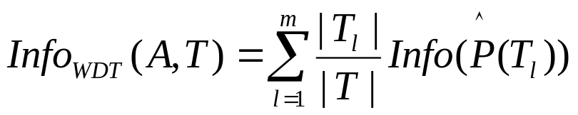
Using EPs to build Weighted Decision Trees
Instead of crisp class membership,
  let instances have weighted class membership,
  then build weighted decision trees, where probabilities are computed from the weighted membership.
DeEPs and other EP based classifiers can be used to assign weights.
An instance Xi’s membership in k classes: (Wi1,…,Wik)

Slide 72
Measuring instance quality by emerging patterns Cont.
More effective than k-NN techniques for assigning weights
  Less sensitive to noise
  Not dependent on distance metric
  Takes into account all instances, not just close neighbors

Slide 73
Data cube based contrasts
(Conditional Contrasts)
Gradient (Dong et al 01), cubegrade (Imielinski et al 02 – TR published in 2000):
  Mining syntactically similar cube cells, having significantly different measure values
  Syntactically similar: ancestor-descendant or sibling-sibling pair
  Can be viewed as “conditional contrasts”: two neighboring patterns with big difference in performance/measure
Data cubes useful for analyzing multi-dimensional, multi-level, time-dependent data.
Gradient mining useful for MDML analysis in marketing, business decisioning, medical/scientific studies

Slide 74
Decision support in data cubes
Used for discovering patterns captured in consolidated historical data for a company/organization:
  rules, anomalies, unusual factor combinations
Focus on modeling & analysis of data for decision makers, not daily operations.
Data organized around major subjects or factors, such as customer, product, time, sales.
Cube “contains” huge number of MDML “segment” or “sector” summaries at different levels of details
Basic OLAP operations: Drill down, roll up, slice and dice, pivot
Notes:
Rules: Most profit of Target gained in December.
Anomaly: some sectors do well, some very similar sectors do not?
A spreadsheet user produces one sector summary, after selecting a population and defining/applying the functions

Slide 75
Data Cubes: Base Table & Hierarchies
Base table stores sales volume (measure), a function of product, time, & location (dimensions)
Time
Hierarchical summarization paths
Location
Industry Region Year
Category Country Quarter
Product City Month Week
Office Day
Product
*: all (as top of each dimension)
a base cell

Slide 76

Data Cubes: Derived Cells
Time
Measures: sum, count, avg, max, min, std, …
1Qtr
2Qtr
3Qtr
4Qtr
sum
Product
TV
PC
U.S.A
VCR
sum
Canada
Location
Mexico
(TV,*,Mexico)
sum
All, All, All
Derived cells, different levels of details
Notes:
A cell: roughly summary/statistics of a “sector” of the whole “market”

Slide 77
Data Cubes: Cell Lattice
Compare: cuboid lattice
(*,*,*)
(a1,*,*)
(a2,*,*)
(*,b1,*)
…
…
(a1,b1,*)
(a1,b2,*)
(a2,b1,*)
…
(a1,b1,c1)
(a1,b1,c2)
(a1,b2,c1)

Slide 78
Gradient mining in data cubes
Users want: more powerful (OLAM) support: Find potentially interesting cells from the billions!
  OLAP operations used to help users search in huge space of cells
  Users must do: mousing, eye-balling, memoing, decisioning, …
Gradient mining: Find syntactically similar cells with significantly different measure values
  (teen clothing,California,2006), total-profit=100K
  vs (teen clothing,Pensylvania,2006), total profit = 10K
  A specific OLAM task

Slide 79
LiveSet-Driven Algorithm for constrained gradient mining
Set-oriented processing; traverse the cube while carrying the live set of cells having potential to match descendants of the current cell as gradient cells
  A gradient compares two cells; one is the probe cell, & the other is a gradient cell. Probe cells are ancestor or sibling cells
Traverse the cell space in a coarse-to-fine manner, looking for matchable gradient cells with potential to satisfy gradient constraint
Dynamically prune the live set during traversal
Compare: Naïve method checks each possible cell pair

Slide 80
Pruning probe cells using dimension matching analysis
Defn: Probe cell p=(a₁,…,a_{n}) is matchable with
gradient cell g=(b₁, …, b_{n}) iff
  No solid-mismatch, or
  Only one solid-mismatch but no *-mismatch
A solid-mismatch: if a_{j}≠b_{j} + none of a_{j} or b_{j} is *
A *-mismatch: if a_{j}=* and b_{j}≠*
Thm: cell p is matchable with cell g iff p may make a probe-gradient pair with some descendant of g (using only dimension value info)
1 solid
1 *
p=(00, Tor, *, *)
g=(00, Chi, *,PC)

Slide 81
Sequence based contrasts
We want to compare sequence datasets:
  bioinformatics (DNA, protein), web log, job/workflow history, books/documents
  e.g. compare protein families; compare bible books/versions
Sequence data are very different from relational data
  order/position matters
  unbounded number of “flexible dimensions”
Sequence contrasts in terms of 2 types of comparison:
  Dataset based: Positive vs Negative
    Distinguishing sequence patterns with gap constraints (Ji et al 05, 07)
    Emerging substrings (Chan et al 03)
  Site based: Near marker vs away from marker
    Motifs
    May also involve data classes
Roughly: A site is a position in a sequence where a special marker/pattern occurs

Slide 82
Example sequence contrasts
When comparing the two protein families zf-C2H2 and zf-CCHC, (Ji et al 05, 07) discovered a protein MDS CLHH appearing as a subsequence in 141 of196 protein sequences of zf-C2H2 but never appearing in the 208 sequences in zf-CCHC.
When comparing the first and last books from the Bible, (Ji et al 05, 07) found the subsequences (with gaps) “having horns”, “face worship”, “stones price” and “ornaments price” appear multiple times in sentences in the Book of Revelation, but never in the Book of Genesis.

Slide 83
Sequence and sequence pattern occurrence
A sequence S = e₁e₂e₃…e_{n} is an ordered list of items over a given alphabet.
  E.G. “AGCA” is a DNA sequence over the alphabet {A, C, G, T}.
  “AC” is a subsequence of “AGCA” but not a substring;
  “GCA” is a substring
Given sequence S and a subsequence pattern S’, an occurrence of S’ in S consists of the positions of the items from S’ in S.
EG: consider S = “ACACBCB”
  <1,5>, <1,7>, <3,5>, <3,7> are occurrences of “AB”
  <1,2,5>, <1,2,7>, <1,4,5>, … are occurrences of “ACB”
Defining count and supp for sequences (1)

Slide 84
Maximum-gap constraint satisfaction
A (maximum) gap constraint: specified by a positive integer g.
Given S & an occurrence o_{s} = <i₁, … i_{m}>, if i_{k+1} – i_{k} <= g + 1
for all 1 <= k <m, then o_{s} fulfills the g-gap constraint.
If a subsequence S’ has one occurrence fulfilling a gap constraint, then S’ satisfies the gap constraint.
  The <3,5> occurrence of “AB” in S = “ACACBCB”, satisfies the maximum gap constraint g=1.
  The <3,4,5> occurrence of “ACB” in S = “ACACBCB”satisfies the maximum gap constraint g=1.
  The <1,2,5>, <1,4,5>, <3,4,5> occurrences of “ACB” in S = “ACACBCB”satisfy the maximum gap constraint g=2.
One sequence contributes to at most one to count.
Defining count and supp for sequences (2)

Slide 85
g-MDS Mining Problem
Given two sets pos & neg of sequences, two support thresholds minp & minn, & a maximum gap g, a pattern p is a Minimal Distinguishing Subsequence with g-gap constraint (g-MDS), if these conditions are met:
Given pos, neg, minp, minn and g, the g-MDS mining problem is to find all the g-MDSs.
1. Frequency condition: supp_{pos}(p,g) >= minp;
2. Infrequency condition: supp_{neg}(p,g) <= minn;
3. Minimality condition: There is no subsequence of p satisfying 1 & 2.

Slide 86
Example g-MDS
Given minp=1/3, minn=0, g=1,
  pos = {CBAB, AACCB, BBAAC},
  neg = {BCAB,ABACB}
1-MDS are: BB, CC, BAA, CBA
  “ACC” is frequent in pos & non-occurring in neg, but it is not minimal (its subsequence “CC” meets the first two conditions).

Slide 87
g-MDS mining : Challenges
The min support thresholds in mining distinguishing patterns need to be lower than those used for mining frequent patterns.
  Min supports offer very weak pruning power on the large search space.
Maximum gap constraint is neither monotone nor anti-monotone.
Gap checking requires clever handling.

Slide 88
ConSGapMiner
The ConSGapMiner algorithm works in three steps:
Candidate Generation:
Candidates are generated without duplication. Efficient pruning strategies are employed.
Support Calculation and Gap Checking:
For each generated candidate c, supp_{pos}(c,g) and supp_{neg}(c,g) are calculated using bitset operations.
Minimization:
Remove all the non-minimal patterns (using pattern trees).

Slide 89
ConSGapMiner : Candidate Generation
{ }
ID | Sequence | Class
1 |  | pos
2 |  | pos
3 |  | pos
4 |  | neg
5 |  | neg
CBAB
AACCB
BBAAC
A
(3, 2)
B
(3, 2)
C
(3, 2)
AA
(2, 1)
…
…
…
BCAB
ABACB
AAA (0, 0)
AAB (0, 1)
AAC
(2, 1)
DFS tree
Two counts per node/pattern
Don’t extend pos-infrequent patterns
Avoid duplicates & certain non-minimal g-MDS (e.g. don’t extend g-MDS)
AACA (0, 0)
AACB (1, 1)
AACC (1, 0)
AACBA (0, 0)
AACBB (0, 0)
AACBC (0, 0)

Slide 90
Use Bitset Operation for Gap Checking
Storing projected suffixes and performing scans is expensive.
e.g. Given a sequence
ACTGTATTACCAGTATCG
to check whether AG is a subsequence for g=1:
Projections with prefix A :
ACTGTATTACCAGTATCG
ATTACCAGTATCG
ACCAGTATCG
AGTATCG
ATCG
We encode the occurrences’ ending positions into a bitset and use a series of bitwise operations to generate a new candidate sequence’s bitset.
Projections with AG obtained from the above:
AGTATCG

Slide 91
ConSGapMiner: Support & Gap Checking (1)
Initial Bitset Array Construction: For each item x, construct an array of bitsets to describe where x occurs in each sequence from pos and neg.
Dataset
Initial Bitset Array
ID | Sequence | Class
1 | CBAB | pos
2 | AACCB | pos
3 | BBAAC | pos
4 | BCAB | neg
5 | ABACB | neg
single-item A
0010
11000
00110
0010
10100

Slide 92
ConSGapMiner: Support & Gap Checking (2)
EG: generate mask bitset for X =“A” in sequence 5 (with max gap g = 1):
Two steps: (1) g+1 right shifts; (2) OR the results of the shifts
ID | Sequence | Class
1 |  | pos
2 |  | pos
3 |  | pos
4 |  | neg
5 |  | neg
C
B
A
B
1 0 1 0 0
> >
0 1 0 1 0
A
A
C
C
B
0 1 0 1 0
> >
0 0 1 0 1
B
B
A
A
C
OR
B
C
A
B
A
B
A
C
B
Mask bitset for X :
0 1 1 1 1
Mask bitset: all the legal positions in the sequence at most (g+1)-positions away from tail of an occurrence of the (maximum prefix of the) pattern.

Slide 93
ConSGapMiner: Support & Gap Checking (3)
EG: Generate bitset array (ba) for X’ = “BA” from X = ‘B’(g = 1)
Get ba for X=‘B’
Shift ba(X) to get mask for X’ = ‘BA’
AND ba(‘A’) and mask(X’) to get ba(X’)
ba(X):
0101
00001
11000
1001
01001
mask(X’):
0011
00000
01110
0110
00110
Number of arrays with some 1 = count
2 shifts plus OR
ID | Sequence | Class
1 |  | pos
2 |  | pos
3 |  | pos
4 |  | neg
5 |  | neg
C
B
A
B
mask(X’):
0011
00000
01110
0110
00110
ba(‘A’):
0010
11000
00110
0010
10100
A
A
C
C
B
ba(X’):
0010
00000
00110
0010
00100
B
B
A
A
C
&
B
C
A
B
A
B
A
C
B

Slide 94
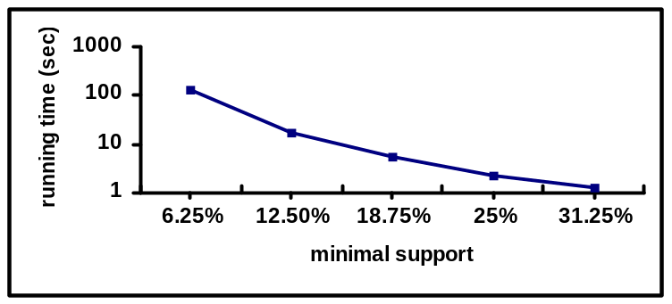
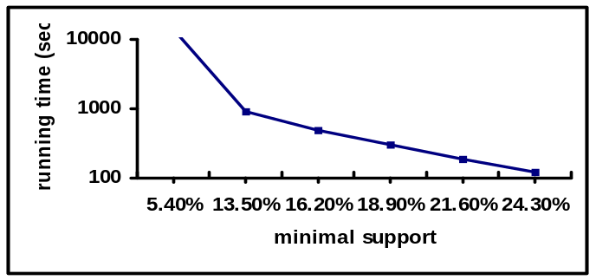
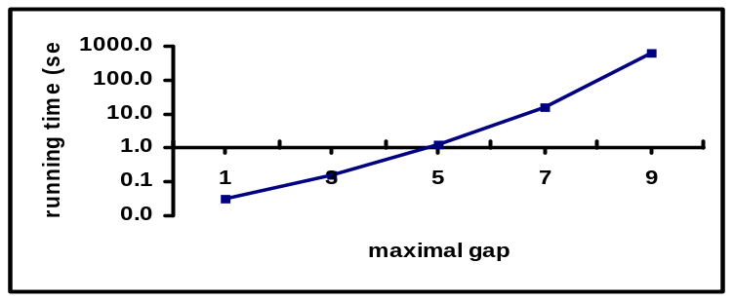
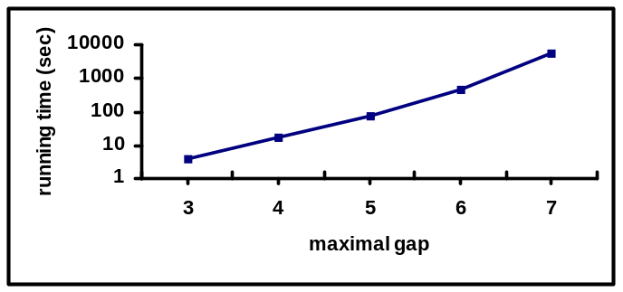
Execution time performance on protein families
Pos(#) | Neg(#) | Avg. Len. (Pos, Neg)
DUF1694 (16) | DUF1695 (5) | (123, 186)
Pos(#) | Neg(#) | Avg. Len. (Pos, Neg)
TatC (74) | TatD_DNase(119) | (205, 262)
runtime vs support, for g = 5
runtime vs support, for g = 5
runtime vs g, for α = 0.3125(5)
runtime vs g, for α = 0.27(20)

Slide 95
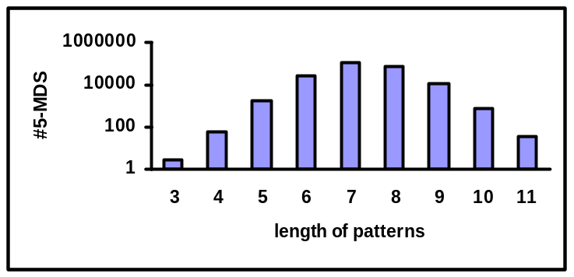
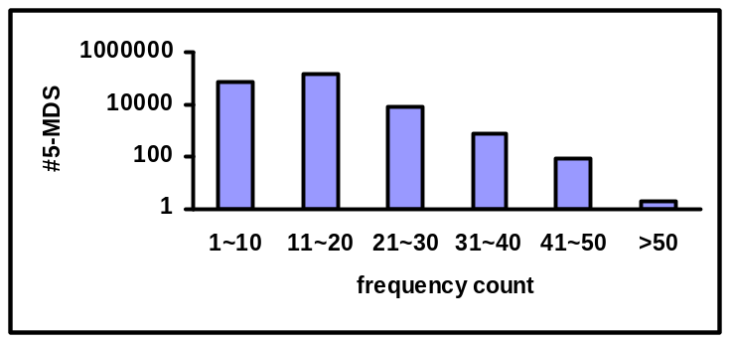
Pattern Length Distribution
-- Protein Families
The length and frequency distribution of patterns: TaC vs TatD_DNase, g = 5, α =13.5%.
Length distribution
Frequency distribution

Slide 96
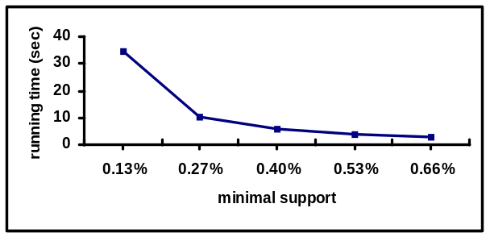
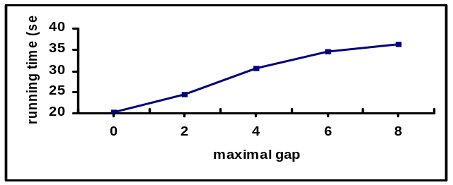
Bible Books Experiment
New Testament (Matthew, Mark, Luke and John) vs
Old Testament (Genesis, Exodus, Leviticus and Numbers):
#Pos | #Neg | Alphabet | Avg. Len. | Max. Len.
3768 | 4893 | 3344 | 7 | 25
runtime vs support, for g = 6.
Some interesting terms found from the Bible books (New Testament vs Old Testament):
Substrings (count) | Subsequences (count)
eternal life (24) | seated hand (10)
good news (23) | answer truly (10)
Forgiveness in (22) | Question saying (13)
Chief priests (53) | Truly kingdom (12)
runtime vs g, for α = 0.0013.

Slide 97
Extensions
Allowing min gap constraint
Allowing max window length constraint
Considering different minimization strategies:
  Subsequence-based minimization (described on previous slides)
  Coverage (matching tidset containment) + subsequence based minimization
  Prefix based minimization

Slide 98
Motif mining
Find sequence patterns frequent around a site marker, but infrequent elsewhere
Can also consider two classes:
  Find patterns frequent around site marker in +ve class, but in frequent at other positions, and infrequent around site marker in –ve class
  Often, biological studies use background probabilities instead of a real -ve dataset
Popular concept/tool in biological studies
Motif representations: Concensus, Markov chain, HMM, ProfileHMM, …(see Dong, Pei: Sequence Data Mining, Springer 2007)

Slide 99
Contrasts for Graph Data
Can capture structural differences
  Subgraphs appearing in one class but not in the other class
    Chemical compound analysis
    Social network comparison

Slide 100
Contrasts for graph data Cont.
Standard frequent subgraph mining
  Given a graph database, find connected subgraphs appearing frequently
Contrast subgraphs particularly focus on discrimination and minimality

Slide 101
Minimal contrast subgraphs [Ting and Bailey 06]
A contrast graph is a subgraph appearing in one class of graphs and never in another class of graphs
  Minimal if none of its subgraphs are contrasts
  May be disconnected
    Allows succinct description of differences
    But requires larger search space
Will focus on one versus one case

Slide 102
Contrast subgraph example
Positive
v₀(a)
Negative
v₀(a)
e₀(a)
e₁(a)
e₀(a)
e₁(a)
e₂(a)
v₁(a)
v₂(a)
v₁(a)
v₂(a)
e₂(a)
e₃(a)
e₃(a)
e₄(a)
v₃(c)
v₃(a)
e₄(a)
v₄(a)
Graph A
Graph B
v₀(a)
v₀(a)
Contrast
Contrast
Contrast
e₀(a)
e₁(a)
e₀(a)
e₂(a)
v₃(c)
v₃(c)
v₁(a)
v₂(a)
v₁(a)
Graph C
Graph D
Graph E

Slide 103
Minimal contrast subgraphs
Minimal contrast graphs are of two types
  Those with only vertices (a vertex set)
  Those without isolated vertices (edge sets)
Can prove that for 1-1 case, the minimal contrast subgraphs are the union of
Min. Con. Vertex Sets + Min. Con. Edge Sets

Slide 104
Mining contrast subgraphs
Main idea
  Find the maximal common edge sets
    These may be disconnected
  Apply a minimal hypergraph transversal operation to derive the minimal contrast edge sets from the maximal common edge sets
  Must compute minimal contrast vertex sets separately and then minimal union with the minimal contrast edge sets

Slide 105
Contrast graph mining workflow
Negative
Graph
G_{n1}
Maximal Common
Edge Sets 1
(Maximal Common Vertex Sets 1)
Maximal Common
Edge Sets
(Maximal Common Vertex Sets)
Complements of Maximal Common
Edge Sets
(Complements of Maximal Common Vertex Sets)
Minimal Contrast
Edge Sets
(Minimal Vertex
Sets)
Positive
Graph
G_{p}
Negative
Graph
G_{n2}
Maximal Common
Edge Sets 2
(Maximal Common Vertex Sets 2) _{_x0003__x0016__x0003_}
Minimal
Transversals
Complement
Negative
Graph
G_{n3_x0016__x0003_}
Maximal Common
Edge Sets 3
(Maximal Common Vertex Sets 1)

Slide 106
Using discriminative graphs for containment search and indexing [Chen et al 07]
Given a graph database and a query q. Find all graphs in the database contained in q.
Applications
  Querying image databases represented as attributed relational graphs. Efficiently find all objects from the database contained in a given scene (query).
query graph q
models contained by q
model graph database D

Slide 107
Discriminative graphs for indexing Cont.
Main idea:
  Given a query graph q and a database graph g
    If a feature f is not contained in q and f is contained in g, then g is not contained in q
Also exploit similarity between graphs.
  If f is a common substructure between g1 and g2, then if f is not contained in the query, both g1 and g2 are not contained in the query

Slide 108
Graph Containment Example [From Chen et al 07]
 | g_{a} | g_{b} | g_{c}
f₁ | 1 | 1 | 1
f₂ | 1 | 1 | 0
f₃ | 1 | 1 | 0
f₄ | 1 | 0 | 0
(g_{a})
(g_{b})
(g_{c})
A Sample Database
(f₁)
(f₂)
(f₃)
(f₄)
Features

Slide 109
Discriminative graphs for indexing
Aim to select the ``contrast features’’ that have the most pruning power (save most isomorphism tests)
These are features that are contained by many graphs in the database, but are unlikely to be contained by a query graph.
Generate lots of candidates using a frequent subgraph mining and then filter output graphs for discriminative power

Slide 110
Generating the Index
After the contrast subgraphs have been found, select a subset of them
  Use a set cover heuristic to select a set that ``covers’’ all the graphs in the database, in the context of a given query q
  For multiple queries, use a maximum coverage with cost approach

Slide 111
Contrasts for trees
Special case of graphs
  Lower complexity
  Lots of activity in the document/XML area, for change detection.
Notions such as edit distance more typical for this context

Slide 112
Contrasts of models
Models can be clusterings, decision trees, …
Why is contrasting useful here ?
  Contrast/compare a user generated model against a known reference model, to evaluate accuracy/degree of difference.
  May wish to compare degree of difference between one algorithm using varying parameters
  Eliminate redundancy among models by choosing dissimilar representatives

Slide 113
Contrasts of models Cont.
Isn’t this just a dissimilarity measure ? Like Euclidean distance ?
  Similar, but operating on more complex objects, not just vectors
Difficulties are
  For rule based classifiers, can’t just report on number of different rules

Slide 114
Clustering comparison
Popular clustering comparison measures
  Rand index and Jaccard index
    Measure the proportion of point pairs on which the two clusterings agree
  Mutual information
    How much information one clustering gives about the other
  Clustering error
    Classification error metric

Slide 115
Clustering Comparison Measures
Nearly all techniques use a ‘Confusion Matrix’ of two clusterings. Example : Let C = {c₁, c₂, c₃) and C’ = {c’₁, c’₂, c’₃}
m | c₁ | c₂ | c₃
c’₁ | 5 | 14 | 1
c’₂ | 10 | 2 | 8
c’₃ | 8 | 7 | 5
m_{ij} = | c_{i} ∩ c’_{j}|

Slide 116
Pair counting
Considers the number of points on which two clusterings agree or disagree. Each pair falls into one of four categories
  N₁₁ – number of pairs of points which are
  in the same cluster in both C and C’
  N₀₀ – number of pairs of points which are
  not in the same cluster in both C and C’
  N₁₀ – number of pairs of points which are
  in the same cluster in C but not in C’
  N₀₁ – number of pairs of points which are
  in the same cluster in C’ but not in C
  N - total number of pairs of points

Slide 117
Pair Counting
Two popular indexes - Rand and Jaccard
  Rand(C,C’) =
  N₁₁ + N₀₀
N
  Jaccard(C,C’) =
N₁₁
N₁₁ + N₀₁ + N₁₀

Slide 118
Clustering Error Metric (Classification Error Metric)
An injective mapping of C={1,…,K} into
C’={1…,K’}. Need to find maximum intersection for all possible mappings.
Best match is
{c₂, c’₁}, {c₁, c’₂},
{c₃, c’_{3}}}
m | c₁ | c₂ | c₃
c’₁ | 5 | 14 | 1
c’₂ | 10 | 2 | 8
c’₃ | 8 | 7 | 5
Clustering error=
(14+10+5)/60=0.483

Slide 119
Clustering Comparison Difficulties
Which most similar to clustering (a)?
Rand(a,b)=Rand(a,c) Jaccard(a,b)=Jaccard(a,c) !
Reference
(a)
(b)
(c)

Slide 120
Comparing datasets via induced models
Given two datasets, we may compare their difference, by considering the difference or deviation between the models that can be induced from them
Models here can refer to decision trees, frequent itemsets, emerging patterns, etc
May also compare an old model to a new dataset
  How much does it misrepresent ?

Slide 121
The FOCUS Framework [Ganti et al 02]
Develops a single measure for quantifying the difference between the interesting characteristics in each dataset.
Key Idea: ``A model has a structural component that identifies interesting regions of the attribute space … each such region is summarized by one (or several) measure(s)’’
Difference between two classifiers is measured by amount of work needed to change them into some common specialization

Slide 122
Focus Framework Cont.
For comparing two models, divide the models each into regions and then compare the regions individually
  For a decision tree, compare leaf nodes of each model
  Aggregate the pairwise differences between each of the regions

Slide 123
Decision tree example [Taken from Ganti et 02]
(class1,class2)
(class1’,class2’)
(class1-class1’)
[0.0-0.0]
(0.1,0.0)
(0.05,0.55)
(0.18,0.1)
(0.1,0.52)
①
[0.1-0.14]
②
_x0016_[0.05-0.1]
100K
(0.0,0.3)
100K
[0.0-0.04]
80K
(0.0,0.1)
80K
[0.0-0.0]
Salary
Salary
Salary
Age
30
Age
50
Age
30
50
[0.0-0.0]
T1:D1
T2:D2
T3: GCR of T1 and T2
(just for class1)
Difference(D1,D2)=|0.0-0.0|+|0.0-0.04|+|0.1-0.14|+|0.0-0.0|+|0.0-0.0|+|0.05-0.1|
=0.13

Slide 124
Correspondence Tracing of Changes [Wang et al 03]
Correspondence tracing aims to make change between the two models understandable by explicitly describing changes and then ranking them

Slide 125
Correspondence Tracing Example [Taken from Wang et al 03]
Consider old and new rule based classifiers
Old ID’s of instances classified
  O1: If A4=1 then C3 [0,2,7,9,13,15,17]
  O2: If A3=1 and A4=2 then C2 [1,4,6,10,12,16]
  O3: If A3=2 and A4=2 then C1 [3,5,8,11,14]
New
  N1: If A3=1 and A4=1 then C3 [0,9,15]
  N2: If A3=1 and A4=2 then C2 [1,4,6,10,12,16]
  N3: If A3=2 and A4=1 then C2 [2,7,13,17]
  N4: If A3=2 and A4=2 then C1 [3,5,8,11,14]

Slide 126
Correspondence Example cont.
Rules N1 and N3 classify the examples that were classified by rule O1. So the changes for the sub population covered by O1 can be described as
<O1,N1> and <O1,N3>
Changes <O2,N2> and <O3,N4> are trivial because the old and new rules are identical.

Slide 127
Rule Accuracy Increase.
The quantitative change Q of <O,N> is the estimated accuracy increase (+ or -) due to the change from O to N.
Changes are ranked according to quantitative change Q and then presented to the user

Slide 128
Common themes for contrast mining
Different representations
  Minimality is the most common
  Support/ratio constraints quite popular, though not necessarily the best
  Conjunctions most popular for relational case
Large number of contrast patterns are output

Slide 129
Recommendations to Practitioners
Some important points are
  Contrast patterns can capture distinguishing patterns between classes
  Contrast patterns can be used to build high quality classifiers
  Contrast patterns can capture useful patterns for detecting/treating diseases, or other events/conditions

Slide 130
Open Problems in Contrast Data Mining
How to meaningfully assess quality of contrasts, especially for non-relational data.
How to explain the semantics of contrasts
Mining of contrasts using user specified domain knowledge
Highly expressive contrasts (first order ..)
Develop new ways to build contrast based classifiers and finding the highest impact contrasts
  Rare class classification and contrasts still an unsettled issue
Discovery of contrasts in massive datasets.
  Efficiently mine contrasts when there are thousands of attributes, such as in medical domains
  Efficient mining of top-k contrast patterns
  Are there meaningful approximations (e.g. sampling) ?

Slide 131
Summary
We have given a wide survey of contrast mining. It should now be clearer
  Why contrast data mining is important and when it can be used
  How it can be used for very powerful classifiers
  What algorithms can be used for contrast data mining

Slide 132
Acknowledgements
We are grateful to the following people for their helpful comments or materials for this tutorial
  Eric Bae
  Jiawei Han
  Xiaonan Ji
  Rao Kotagiri
  Jinyan Li
  Elsa Loekito
  Katherine Ramsay
  Limsoon Wong

Slide 133
Bibliography
This bibliography contains three sections:
Mining of Emerging Patterns, Change Patterns, Contrast/Difference Patterns
Emerging/Contrast Pattern Based Classification
Other Applications of Emerging Patterns
Please let us know of any extra references to include !

Slide 134
Bibliography (Mining of Emerging Patterns, Change Patterns, Contrast/Difference Patterns)
Arunasalam, Bavani and Chawla, Sanjay and Sun, Pei. Striking Two Birds with One Stone: Simultaneous Mining of Positive and Negative Spatial Patterns. In Proceedings of the Fifth SIAM International Conference on Data Mining, April 21-23, pp, Newport Beach, CA, USA, SIAM 2005
Bavani Arunasalam, Sanjay Chawla: CCCS: a top-down associative classifier for imbalanced class distribution. KDD 2006: 517-522
Eric Bae, James Bailey, Guozhu Dong: Clustering Similarity Comparison Using Density Profiles. Australian Conference on Artificial Intelligence 2006: 342-351
James Bailey, Thomas Manoukian, Kotagiri Ramamohanarao: Fast Algorithms for Mining Emerging Patterns. PKDD 2002: 39-50.
J. Bailey and T. Manoukian and K. Ramamohanarao: A Fast Algorithm for Computing Hypergraph Transversals and its Application in Mining Emerging Patterns. Proceedings of the 3rd IEEE International Conference on Data Mining (ICDM). Pages 485-488. Florida, USA, November 2003.
Stephen D. Bay, Michael J. Pazzani: Detecting Change in Categorical Data: Mining Contrast Sets. KDD 1999: 302-306.
Stephen D. Bay, Michael J. Pazzani: Detecting Group Differences: Mining Contrast Sets. Data Min. Knowl. Discov. 5(3): 213-246 (2001)
Cristian Bucila, Johannes Gehrke, Daniel Kifer, Walker M. White: DualMiner: A Dual-Pruning Algorithm for Itemsets with Constraints. Data Min. Knowl. Discov. 7(3): 241-272 (2003)
Yandong Cai, Nick Cercone, Jiawei Han: An Attribute-Oriented Approach for Learning Classification Rules from Relational Databases. ICDE 1990: 281-288
Sarah Chan, Ben Kao, Chi Lap Yip, Michael Tang: Mining Emerging Substrings. DASFAA 2003.
Yixin Chen, Guozhu Dong, Jiawei Han, Jian Pei, Benjamin W. Wah, Jianyong Wang: Online Analytical Processing Stream Data: Is It Feasible? DMKD 2002
Chen Chen, Xifeng Yan, Philip S. Yu, Jiawei Han, Dong-Qing Zhang, Xiaohui Gu: Towards Graph Containment Search and Indexing. VLDB 2007: 926-937

Slide 135
Bibliography (Mining of Emerging Patterns, Change Patterns, Contrast/Difference Patterns)
Graham Cormode, S. Muthukrishnan: What's new: finding significant differences in network data streams. IEEE/ACM Trans. Netw. 13(6): 1219-1232 (2005)
Luc De Raedt, Albrecht Zimmermann: Constraint-Based Pattern Set Mining. SDM 2007
Luc De Raedt: Towards Query Evaluation in Inductive Databases Using Version Spaces. Database Support for Data Mining Applications 2004: 117-134
Luc De Raedt, Stefan Kramer: The Levelwise Version Space Algorithm and its Application to Molecular Fragment Finding. IJCAI 2001: 853-862
Guozhu Dong, Jinyan Li: Efficient Mining of Emerging Patterns: Discovering Trends and Differences. KDD 1999: 43-52.
Guozhu Dong, Jinyan Li: Mining border descriptions of emerging patterns from dataset pairs. Knowl. Inf. Syst. 8(2): 178-202 (2005).
Dong, G. and Han, J. and Lakshmanan, L.V.S. and Pei, J. and Wang, H. and Yu, P.S. Online Mining of Changes from Data Streams: Research Problems and Preliminary Results, Proceedings of the 2003 ACM SIGMOD Workshop on Management and Processing of Data Streams, 2003
Guozhu Dong, Jiawei Han, Joyce M. W. Lam, Jian Pei, Ke Wang, Wei Zou: Mining Constrained Gradients in Large Databases. IEEE Trans. Knowl. Data Eng. 16(8): 922-938 (2004).
Johannes Fischer, Volker Heun, Stefan Kramer: Optimal String Mining Under Frequency Constraints. PKDD 2006: 139-150
Venkatesh Ganti, Johannes Gehrke, Raghu Ramakrishnan: A Framework for Measuring Changes in Data Characteristics. PODS 1999: 126-137
Venkatesh Ganti, Johannes Gehrke, Raghu Ramakrishnan, Wei-Yin Loh: A Framework for Measuring Differences in Data Characteristics. J. Comput. Syst. Sci. 64(3): 542-578 (2002)
Garriga, G.C. and Kralj, P. and Lavrac, N. Closed Sets for Labeled Data?, PKDD, 2006
Hilderman, R.J. and Peckham, T. A Statistically Sound Alternative Approach to Mining Contrast Sets, Proceedings of the 4th Australasian Data Mining Conference, 2005 (pp157-172)

Slide 136
Bibliography (Mining of Emerging Patterns, Change Patterns, Contrast/Difference Patterns)
Hui-jing Huang, Yongsong Qin, Xiaofeng Zhu, Jilian Zhang, and Shichao Zhang. Difference Detection Between Two Contrast Sets. Proceedings of the 8th International Conference on Data Warehousing and Knowledge Discovery (DaWak), 2006.
Imberman, S.P. and Tansel, A.U. and Pacuit, E. An Efficient Method For Finding Emerging Frequent Itemsets, 3rd International Workshop on Mining Temporal and Sequential Data, pp112--121, 2004
Tomasz Imielinski, Leonid Khachiyan, Amin Abdulghani: Cubegrades: Generalizing Association Rules. Data Min. Knowl. Discov. 6(3): 219-257 (2002)
Inakoshi, H. and Ando, T. and Sato, A. and Okamoto, S. Discovery of emerging patterns from nearest neighbors, International Conference on Machine Learning and Cybernetics, 2002.
Xiaonan Ji, James Bailey, Guozhu Dong: Mining Minimal Distinguishing Subsequence Patterns with Gap Constraints. ICDM 2005: 194-201.
Xiaonan Ji, James Bailey, Guozhu Dong: Mining Minimal Distinguishing Subsequence Patterns with Gap Constraints. Knowl. Inf. Syst. 11(3): 259--286 (2007).
Daniel Kifer, Shai Ben-David, Johannes Gehrke: Detecting Change in Data Streams. VLDB 2004: 180-191
P Kralj, N Lavrac, D Gamberger, A Krstacic. Contrast Set Mining for Distinguishing Between Similar Diseases. LNCS Volume 4594, 2007.
Sau Dan Lee, Luc De Raedt: An Efficient Algorithm for Mining String Databases Under Constraints. KDID 2004: 108-129
Haiquan Li, Jinyan Li, Limsoon Wong, Mengling Feng, Yap-Peng Tan: Relative risk and odds ratio: a data mining perspective. PODS 2005: 368-377
Jinyan Li, Guimei Liu and Limsoon Wong. Mining Statistically Important Equivalence Classes and delta-Discriminative Emerging Patterns. KDD 2007.
Jinyan Li, Thomas Manoukian, Guozhu Dong, Kotagiri Ramamohanarao: Incremental Maintenance on the Border of the Space of Emerging Patterns. Data Min. Knowl. Discov. 9(1): 89-116 (2004).

Slide 137
Bibliography (Mining of Emerging Patterns, Change Patterns, Contrast/Difference Patterns)
Jinyan Li and Qiang Yang. Strong Compound-Risk Factors: Efficient Discovery through Emerging Patterns and Contrast Sets. IEEE Transactions on Information Technology in Biomedicine. To appear.
Lin, J. and Keogh, E. Group SAX: Extending the Notion of Contrast Sets to Time Series and Multimedia Data. Proceedings of the 10th european conference on principles and practice of knowledge discovery in databases. Berlin, Germany, September, 2006.
Bing Liu, Ke Wang, Lai-Fun Mun, Xin-Zhi Qi: Using Decision Tree Induction for Discovering Holes in Data. PRICAI 1998: 182-193
Bing Liu, Liang-Ping Ku, Wynne Hsu: Discovering Interesting Holes in Data. IJCAI (2) 1997: 930-935
Bing Liu, Wynne Hsu, Yiming Ma: Discovering the set of fundamental rule changes. KDD 2001: 335-340.
Elsa Loekito, James Bailey: Fast Mining of High Dimensional Expressive Contrast Patterns Using Zero-suppressed Binary Decision Diagrams. KDD 2006: 307-316.
Yu Meng, Margaret H. Dunham: Efficient Mining of Emerging Events in a Dynamic Spatiotemporal Environment. PAKDD 2006: 750-754
Tom M. Mitchell: Version Spaces: A Candidate Elimination Approach to Rule Learning. IJCAI 1977: 305-310
Amit Satsangi, Osmar R. Zaiane, Contrasting the Contrast Sets: An Alternative Approach, Eleventh International Database Engineering and Applications Symposium (IDEAS 2007), Banff, Canada, September 6-8, 2007
Michele Sebag: Delaying the Choice of Bias: A Disjunctive Version Space Approach. ICML 1996: 444-452
Michele Sebag: Using Constraints to Building Version Spaces. ECML 1994: 257-271
Arnaud Soulet, Bruno Crémilleux, François Rioult: Condensed Representation of EPs and Patterns Quantified by Frequency-Based Measures. KDID 2004: 173-190
Pawel Terlecki, Krzysztof Walczak: On the relation between rough set reducts and jumping emerging patterns. Inf. Sci. 177(1): 74-83 (2007).

Slide 138
Bibliography (Mining of Emerging Patterns, Change Patterns, Contrast/Difference Patterns)
Roger Ming Hieng Ting, James Bailey: Mining Minimal Contrast Subgraph Patterns. SDM 2006.
V. S. Tseng, C. J. Chu, and Tyne Liang, An Efficient Method for Mining Temporal Emerging Itemsets From Data Streams, International Computer Symposium, Workshop on Software Engineering, Databases and Knowledge Discovery, 2006
J. Vreeken, M. van Leeuwen, A. Siebes: Characterising the Difference. KDD 2007.
Haixun Wang, Wei Fan, Philip S. Yu, Jiawei Han: Mining concept-drifting data streams using ensemble classifiers. KDD 2003: 226-235
Peng Wang, Haixun Wang, Xiaochen Wu, Wei Wang, Baile Shi: On Reducing Classifier Granularity in Mining Concept-Drifting Data Streams. ICDM 2005: 474-481
Lusheng Wang, Hao Zhao, Guozhu Dong, Jianping Li: On the complexity of finding emerging patterns. Theor. Comput. Sci. 335(1): 15-27 (2005).
Ke Wang, Senqiang Zhou, Ada Wai-Chee Fu, Jeffrey Xu Yu: Mining Changes of Classification by Correspondence Tracing. SDM 2003.
Geoffrey I. Webb: Discovering Significant Patterns. Machine Learning 68(1): 1-33 (2007)
Geoffrey I. Webb, Songmao Zhang: K-Optimal Rule Discovery. Data Min. Knowl. Discov. 10(1): 39-79 (2005)
Geoffrey I. Webb, Shane M. Butler, Douglas A. Newlands: On detecting differences between groups. KDD 2003: 256-265.
Xiuzhen Zhang, Guozhu Dong, Kotagiri Ramamohanarao: Exploring constraints to efficiently mine emerging patterns from large high-dimensional datasets. KDD 2000: 310-314.
Lizhuang Zhao, Mohammed J. Zaki, Naren Ramakrishnan: BLOSOM: a framework for mining arbitrary boolean expressions. KDD 2006: 827-832

Slide 139
Bibliography (Emerging/Contrast Pattern Based Classification)
Hamad Alhammady, Kotagiri Ramamohanarao: The Application of Emerging Patterns for Improving the Quality of Rare-Class Classification. PAKDD 2004: 207-211
Hamad Alhammady, Kotagiri Ramamohanarao: Using Emerging Patterns and Decision Trees in Rare-Class Classification. ICDM 2004: 315-318
Hamad Alhammady, Kotagiri Ramamohanarao: Expanding the Training Data Space Using Emerging Patterns and Genetic Methods. SDM 2005
Hamad Alhammady, Kotagiri Ramamohanarao: Using Emerging Patterns to Construct Weighted Decision Trees. IEEE Trans. Knowl. Data Eng.
18(7): 865-876 (2006).
Hamad Alhammady, Kotagiri Ramamohanarao: Mining Emerging Patterns and Classification in Data Streams. Web Intelligence 2005: 272-275
James Bailey, Thomas Manoukian, Kotagiri Ramamohanarao: Classification Using Constrained Emerging Patterns. WAIM 2003: 226-237
Guozhu Dong, Xiuzhen Zhang, Limsoon Wong, Jinyan Li: CAEP: Classification by Aggregating Emerging Patterns. Discovery Science
1999: 30-42.
Hongjian Fan, Kotagiri Ramamohanarao: An Efficient Single-Scan Algorithm for Mining Essential Jumping Emerging Patterns for Classification. PAKDD 2002: 456-462
Hongjian Fan, Kotagiri Ramamohanarao: Efficiently Mining Interesting Emerging Patterns. WAIM 2003: 189-201
Hongjian Fan, Kotagiri Ramamohanarao: Noise Tolerant Classification by Chi Emerging Patterns. PAKDD 2004: 201-206
Hongjian Fan, Ming Fan, Kotagiri Ramamohanarao, Mengxu Liu: Further Improving Emerging Pattern Based Classifiers Via Bagging. PAKDD 2006: 91-96
Hongjian Fan, Kotagiri Ramamohanarao: A weighting scheme based on emerging patterns for weighted support vector machines. GrC 2005: 435-440

Slide 140
Bibliography (Emerging/Contrast Pattern Based Classification)
Hongjian Fan, Kotagiri Ramamohanarao: Fast Discovery and the Generalization of Strong Jumping Emerging Patterns for Building Compact and Accurate Classifiers. IEEE Trans. Knowl. Data Eng. 18(6): 721-737 (2006)
Jinyan Li, Guozhu Dong, Kotagiri Ramamohanarao: Instance-Based Classification by Emerging Patterns. PKDD 2000: 191-200
Jinyan Li, Guozhu Dong, Kotagiri Ramamohanarao: Making Use of the Most Expressive Jumping Emerging Patterns for Classification. PAKDD 2000: 220-232
Jinyan Li, Guozhu Dong, Kotagiri Ramamohanarao: Making Use of the Most Expressive Jumping Emerging Patterns for Classification. Knowl. Inf. Syst. 3(2): 131-145 (2001)
Jinyan Li, Kotagiri Ramamohanarao, Guozhu Dong: Emerging Patterns and Classification. ASIAN 2000: 15-32
Jinyan Li, Guozhu Dong, Kotagiri Ramamohanarao, Limsoon Wong: DeEPs: A New Instance-Based Lazy Discovery and Classification System. Machine Learning 54(2): 99-124 (2004).
Wenmin Li, Jiawei Han, Jian Pei: CMAR: Accurate and Efficient Classification Based on Multiple Class-Association Rules. ICDM 2001: 369-376
Jinyan Li, Kotagiri Ramamohanarao, Guozhu Dong: Combining the Strength of Pattern Frequency and Distance for Classification. PAKDD 2001: 455-466
Bing Liu, Wynne Hsu, Yiming Ma: Integrating Classification and Association Rule Mining. KDD 1998: 80-86
Kotagiri Ramamohanarao, James Bailey: Discovery of Emerging Patterns and Their Use in Classification. Australian Conference on Artificial Intelligence 2003: 1-12
Ramamohanarao, K. and Bailey, J. and Fan, H. Efficient Mining of Contrast Patterns and Their Applications to Classification, Third International Conference on Intelligent Sensing and Information Processing, 2005 (39--47).
Ramamohanarao, K. and Fan, H. Patterns Based Classifiers, World Wide Web 2007: 10(71--83).
Qun Sun, Xiuzhen Zhang, Kotagiri Ramamohanarao: Noise Tolerance of EP-Based Classifiers. Australian Conference on Artificial Intelligence 2003: 796-806

Slide 141
Bibliography (Emerging/Contrast Pattern Based Classification)
Xiaoxin Yin, Jiawei Han: CPAR: Classification based on Predictive Association Rules. SDM 2003
Xiuzhen Zhang, Guozhu Dong, Kotagiri Ramamohanarao: Information-Based Classification by Aggregating Emerging Patterns. IDEAL 2000: 48-53
Xiuzhen Zhang, Guozhu Dong, Kotagiri Ramamohanarao: Building Behaviour Knowledge Space to Make Classification Decision. PAKDD 2001: 488-494
Zhou Wang, Hongjian Fan, Kotagiri Ramamohanarao: Exploiting Maximal Emerging Patterns for Classification. Australian Conference on Artificial Intelligence 2004: 1062-1068

Slide 142
Bibliography (Other Applications of Emerging Patterns)
Anne-Laure Boulesteix, Gerhard Tutz, Korbinian Strimmer: A CART-based approach to discover emerging patterns in microarray data. Bioinformatics 19(18): 2465-2472 (2003).
Lijun Chen, Guozhu Dong: Masquerader Detection Using OCLEP: One Class Classification Using Length Statistics of Emerging Patterns. Proceedings of International Workshop on INformation Processing over Evolving Networks (WINPEN), 2006.
Guozhu Dong, Kaustubh Deshpande: Efficient Mining of Niches and Set Routines. PAKDD 2001: 234-246
Grandinetti, W.M. and Chesnevar, C.I. and Falappa, M.A. Enhanced Approximation of the Emerging Pattern Space using an Incremental Approach, Proceedings of VII Workshop of Researchers in Computer Sciences, Argentine, pp263--267, 2005
Jinyan Li, Huiqing Liu, See-Kiong Ng, Limsoon Wong. Discovery of Significant Rules for Classifying Cancer Diagnosis Data . Bioinformatics. 19 (suppl. 2): ii93-ii102. (This paper was also presented in the 2003 European Conference on Computational Biology, Paris, France, September 26-30.)
Jinyan Li, Huiqing Liu, James R. Downing, Allen Eng-Juh Yeoh, Limsoon Wong. Simple Rules Underlying Gene Expression Profiles of More than Six Subtypes of Acute Lymphoblastic Leukemia (ALL) Patients. Bioinformatics. 19:71--78, 2003.
Jinyan Li, Limsoon Wong: Emerging patterns and gene expression data. Genome Informatics, 2001:12(3--13).
Jinyan Li, Limsoon Wong: Identifying good diagnostic gene groups from gene expression profiles using the concept of emerging patterns. Bioinformatics 18(5): 725-734 (2002)
Jinyan Li, Limsoon Wong. Geography of Differences Between Two Classes of Data. Proceedings 6th European Conference on Principles of Data Mining and Knowledge Discovery, pages 325--337, Helsinki, Finland, August 2002.
Jinyan Li and Limsoon Wong. Structural Geography of the space of emerging patterns. Intelligent Data Analysis (IDA): An International Journal, Volume 9, pages 567-588, November 2005.
Jinyan Li, Xiuzhen Zhang, Guozhu Dong, Kotagiri Ramamohanarao, Qun Sun: Efficient Mining of High Confidience Association Rules without Support Thresholds. PKDD 1999: 406-411

Slide 143
Bibliography (Other Applications of Emerging Patterns)
Shihong Mao, Guozhu Dong: Discovery of Highly Differentiative Gene Groups from Microarray Gene Expression Data Using the Gene Club Approach. J. Bioinformatics and Computational Biology 3(6): 1263-1280 (2005).
Podraza, R. and Tomaszewski, K. KTDA: Emerging Patterns Based Data Analysis System, Proceedings of XXI Fall Meeting of Polish Information Processing Society, pp213--221, 2005
Rioult, F. Mining strong emerging patterns in wide SAGE data, Proceedings of the ECML/PKDD Discovery Challenge Workshop, Pisa, Italy, pp127--138, 2004
Eng-Juh Yeoh, Mary E. Ross, Sheila A. Shurtleff, W. Kent William, Divyen Patel, Rami Mahfouz, Fred G. Behm, Susana C. Raimondi, Mary V. Reilling, Anami Patel, Cheng Cheng, Dario Campana, Dawn Wilkins, Xiaodong Zhou, Jinyan Li, Huiqing Liu, Chin-Hon Pui, William E. Evans, Clayton Naeve, Limsoon Wong, James R. Downing. Classification, subtype discovery, and prediction of outcome in pediatric acute lymphoblastic leukemia by gene expression profiling. Cancer Cell, 1:133--143, March 2002.
Yoon, H.S. and Lee, S.H. and Kim, J.H. Application of Emerging Patterns for Multi-source Bio-Data Classification and Analysis, LECTURE NOTES IN COMPUTER SCIENCE Vol 3610, 2005.
Yu, L.T.H. and Chung, F. and Chan, S.C.F. and Yuen, S.M.C. Using emerging pattern based projected clustering and gene expression data for cancer detection, Proceedings of the second conference on Asia-Pacific bioinformatics, pp75--84, 2004.
Zhang, X. and Dong, G. and Wong, L. Using CAEP to predict translation initiation sites from genomic DNA sequences, TR2001/22, CSSE, Univ. of Melbourne, 2001.

